Slide 1
Credit EDA Case Study
By
Selvi Duraisamy

Slide 2
Steps performed for Case Study
Study the data (Both the application and previous application data)
Analyze each feature , data distribution , outliers any
Data cleaning activity –
check the Null % and exclude more than 40 % null column values
For the remaining columns impute the missing values by the standard approach learnt
Check and format the data to appropriate datatypes , absolute values
Analysis –
Univariate
Categorical feature
Numerical feature
Bivariate
Categorical vs Numerical feature
Numerical va Numerical
Co-orelation between numerical features
Segmented univariate/bivariate analysis
Conclusion

Slide 3
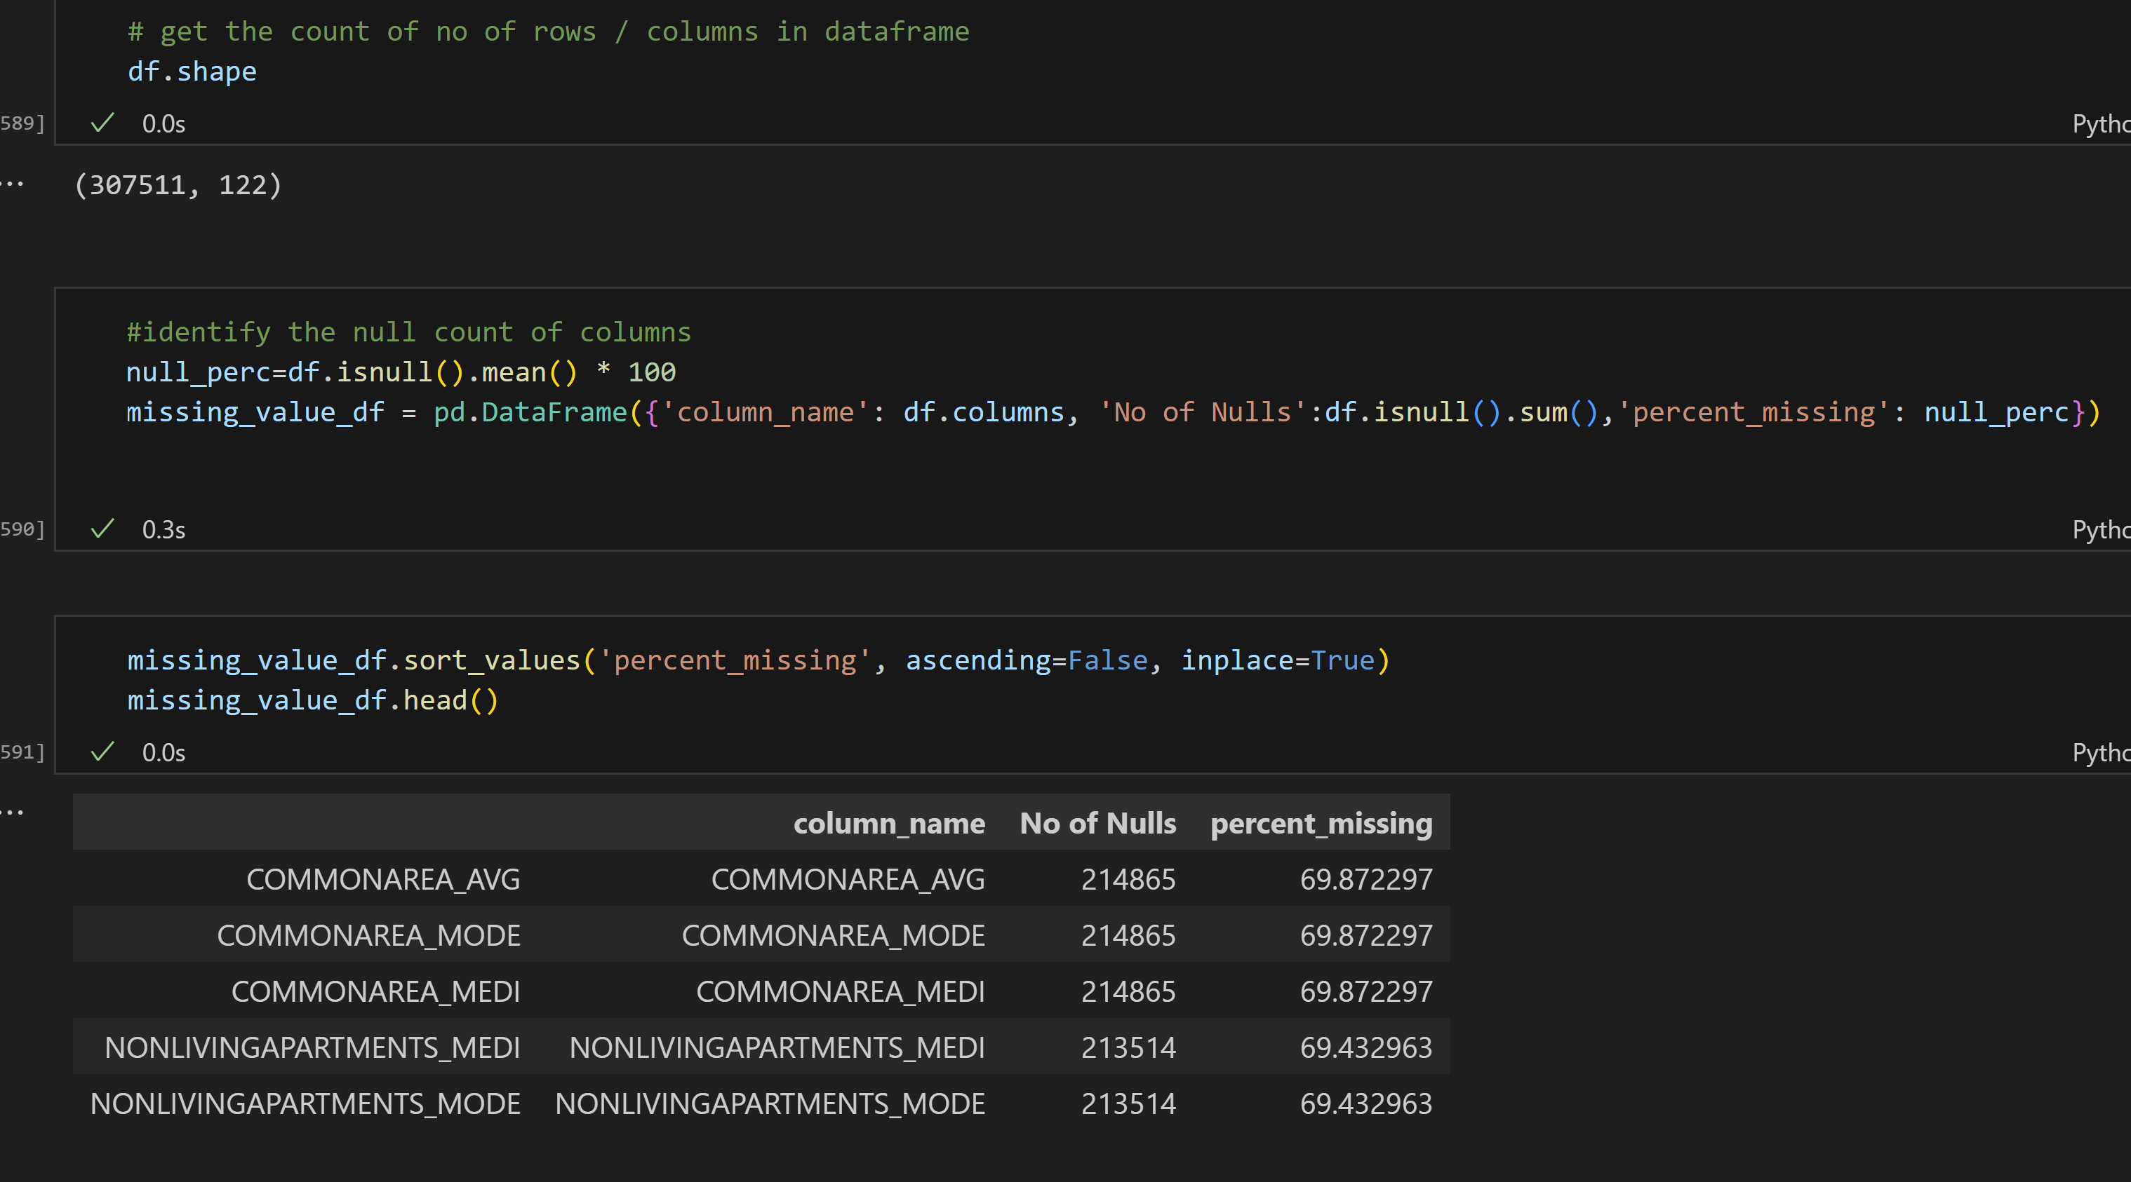
Data Understanding

Slide 4
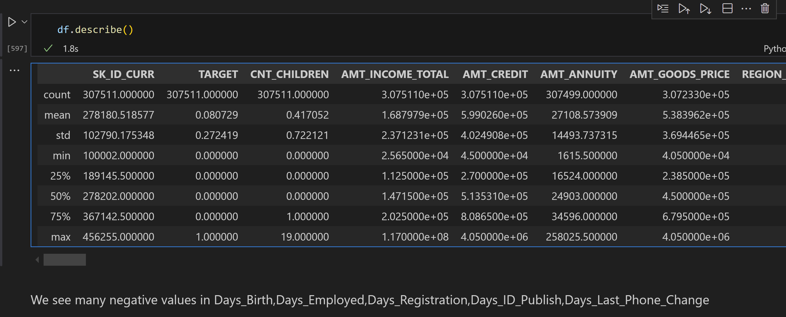
Data Understanding

Slide 5
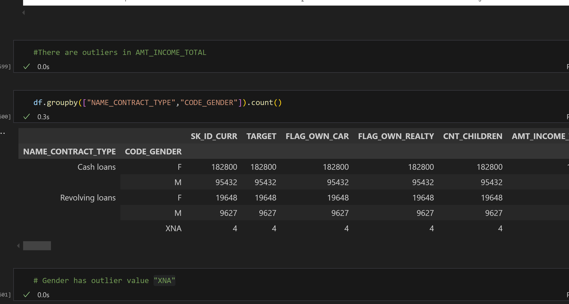
Data Understanding

Slide 6
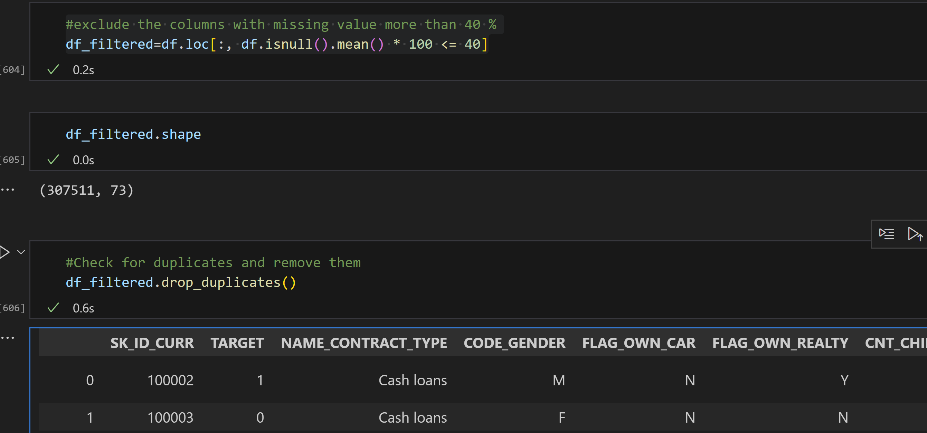
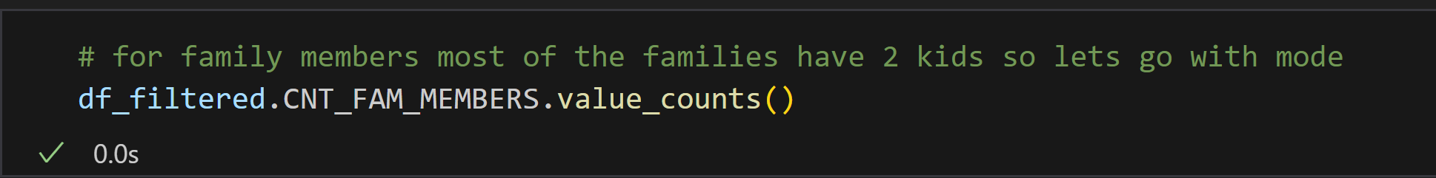
Data Cleaning

Slide 7
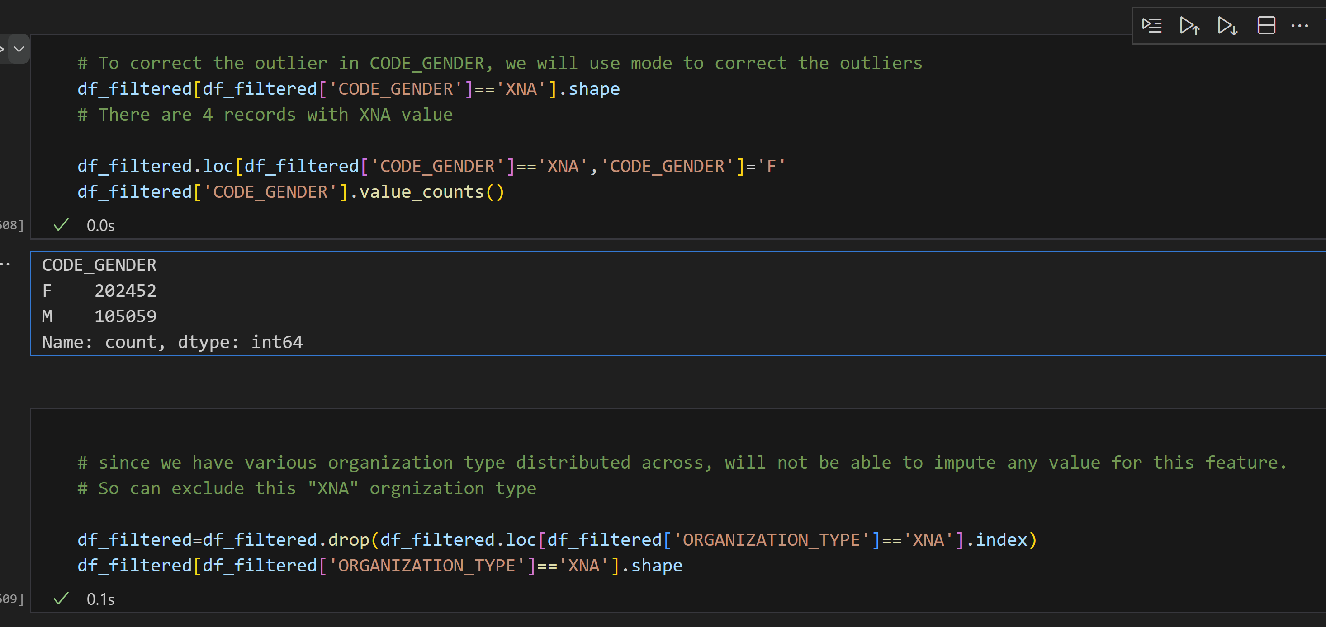
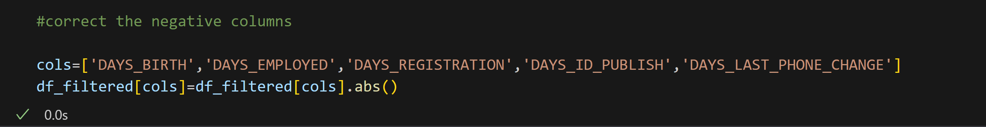
Data Cleaning

Slide 8
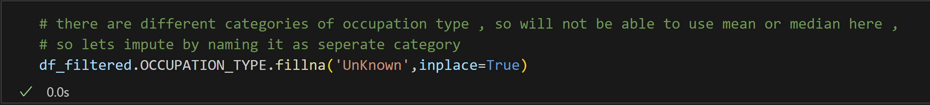
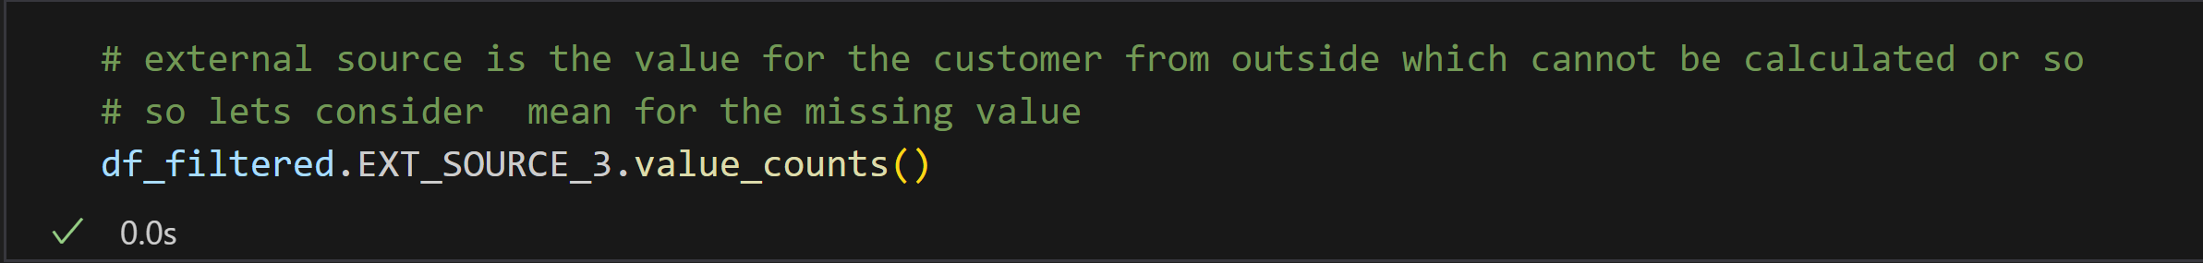
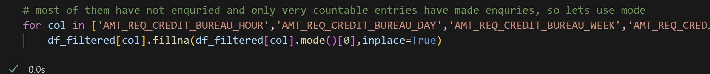
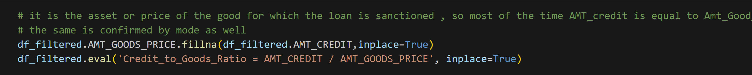
Data Cleaning

Slide 9
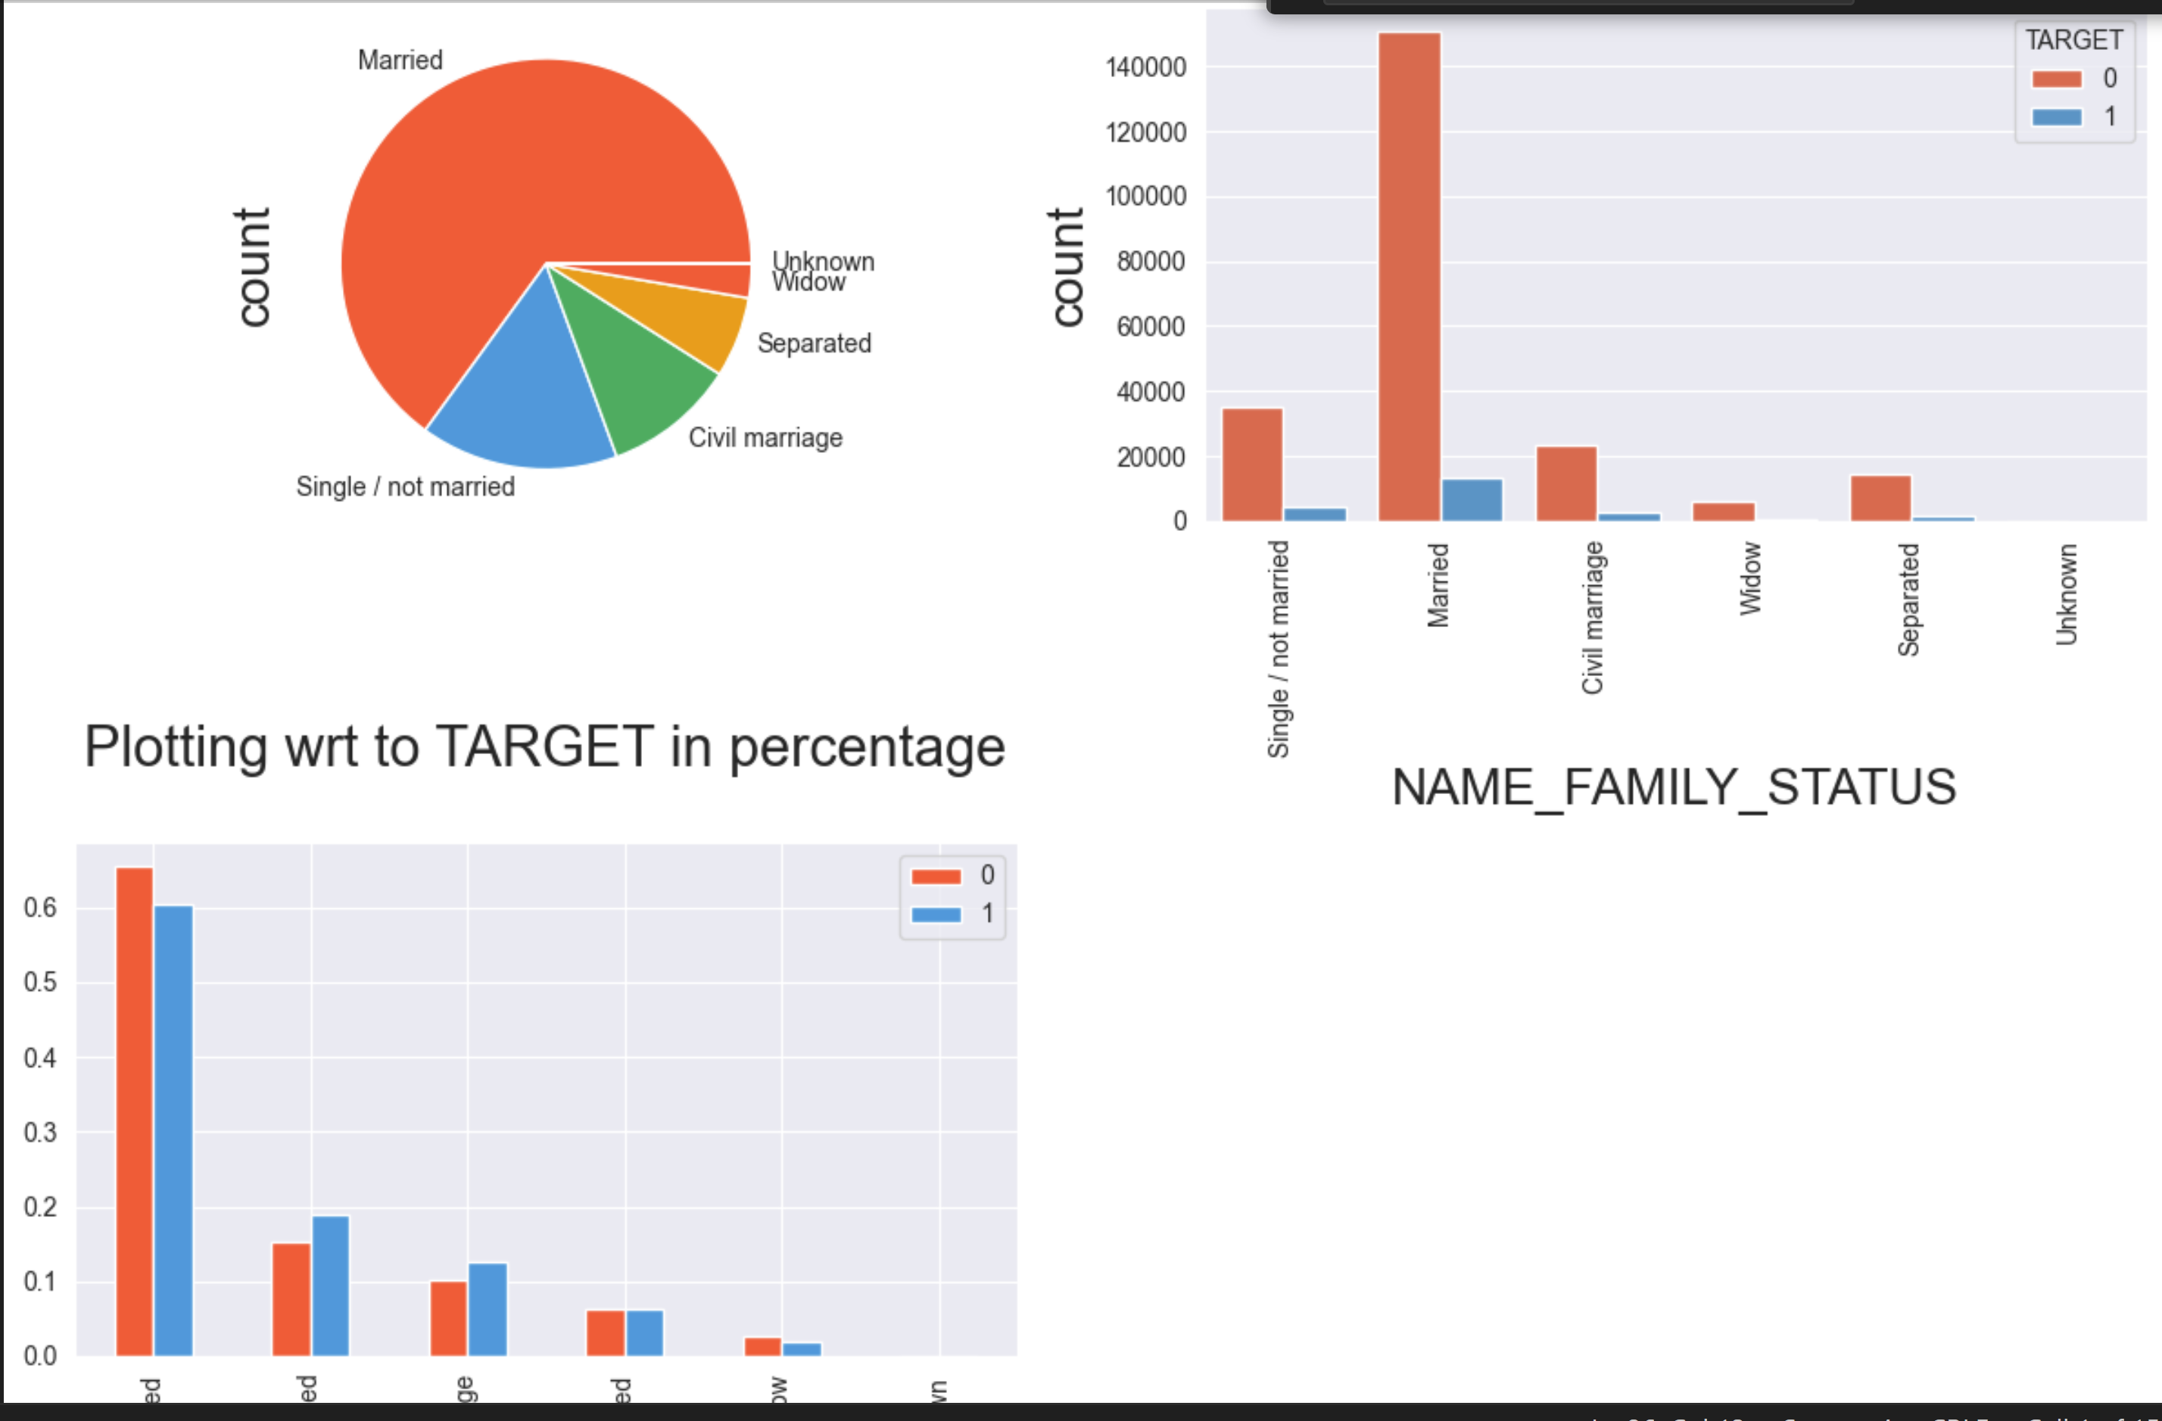
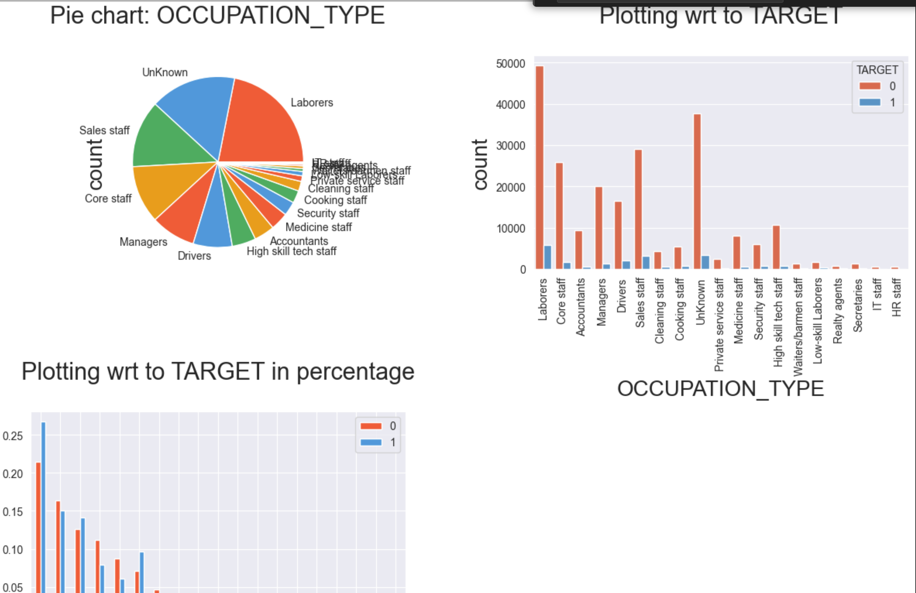
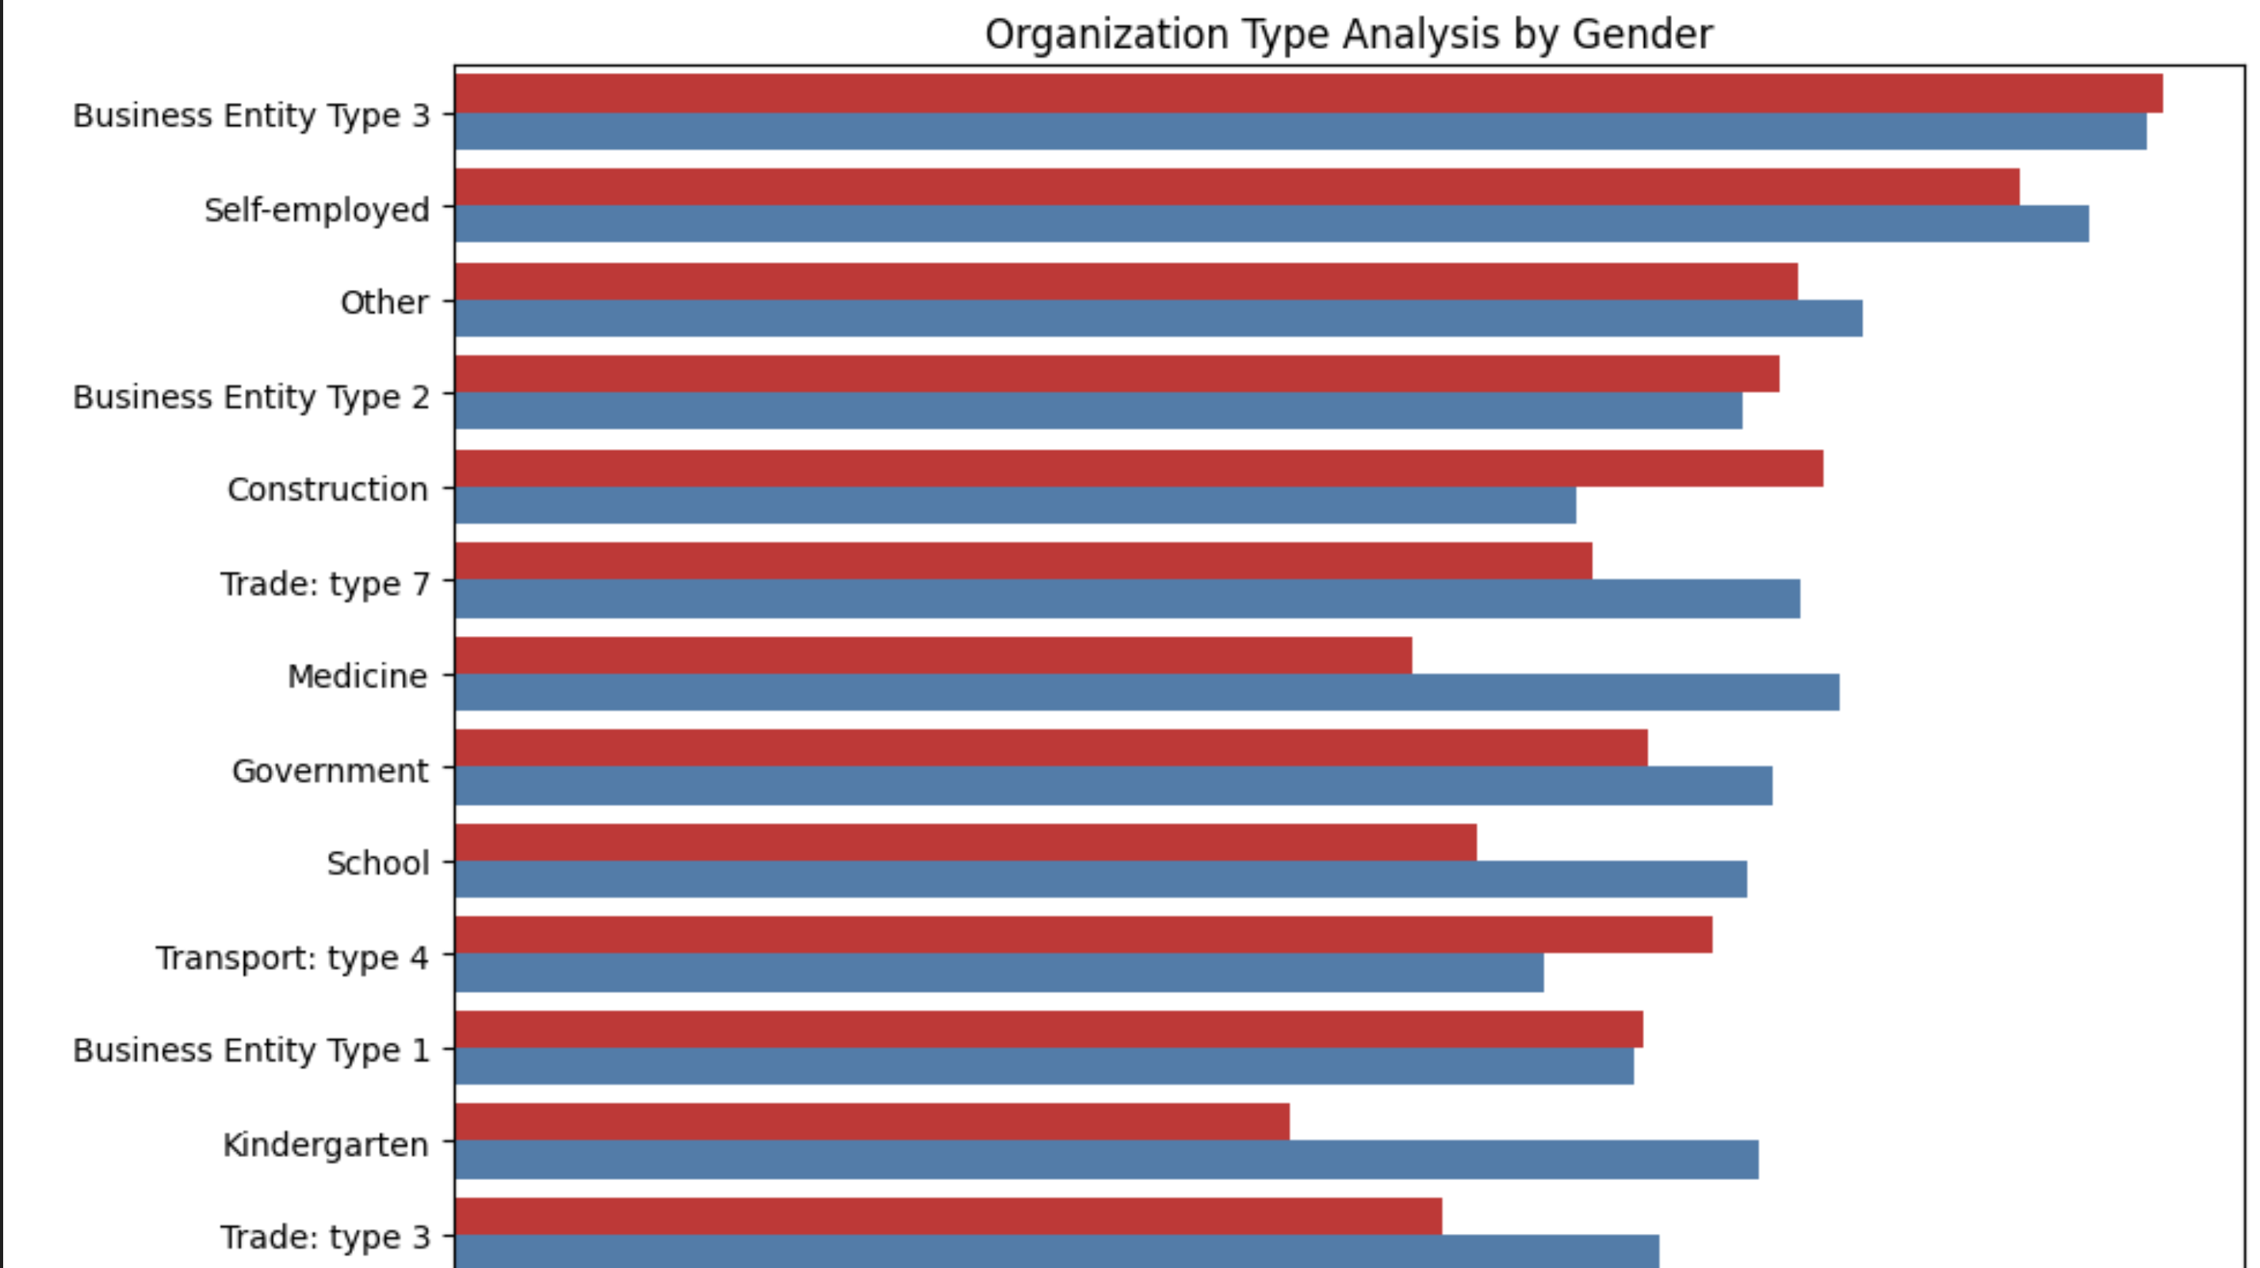
Distribution of Occupation Type

Slide 10
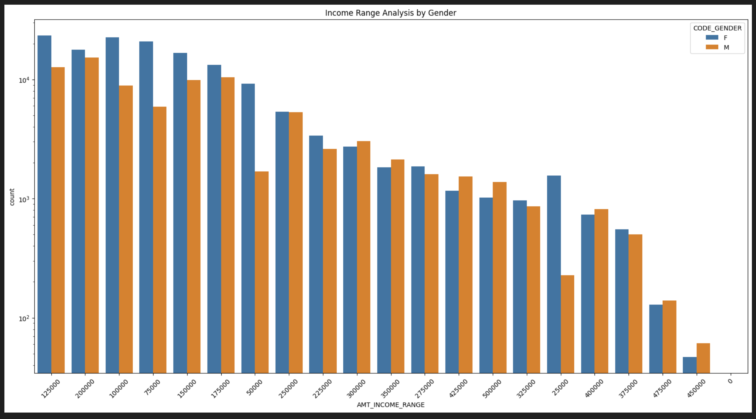
Distribution of income Range
Female counts are higher than male
Females have more credit range than males
Income Range above 400000 is less

Slide 11
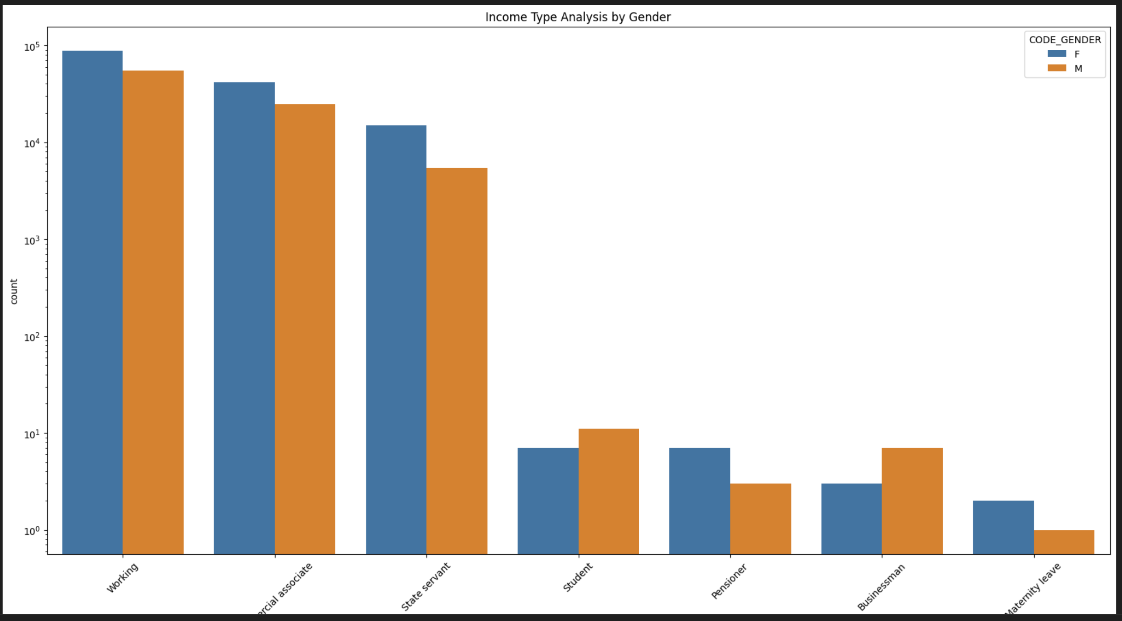
Distribution of income Type
For income type ‘working’, ’commercial associate’, and ‘State Servant’ the number of credits are higher than others.
For this Females are having more number of credits than male.

Slide 12
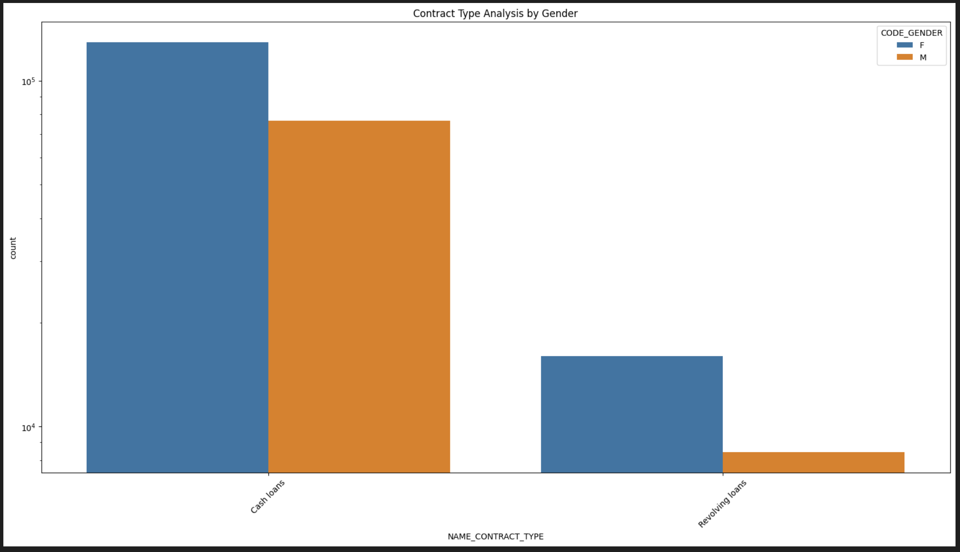
Distribution of Contract Type
For contract type ‘cash loans’ is having higher number of credits than ‘Revolving loans’ contract type.
For this also Female is leading for applying credits.

Slide 13
Conclusion
1. The banks should target following contract type for successful payments.
a. Students
b. Pensioner
b. Businessman
2. ‘Working’ income type should be avoided as they are having most number of unsuccessful payments as well as "laborers" .
3. ‘Repair’ is having higher number of unsuccessful payments on time.
4. "Co-op apartment type" are ones facing high payment difficulties while "office apartment" type loan is good and high in successful payments
5. High percentage of "secondary/special education" type face difficulties in re-paying
6. With respect to gender Male is more defaulter than female

